Slide 1
Buffer Overflow Attacks
Meredith Schmidt, Andrew Rockwell, and Dennis Cornwell
Notes:
Don’t let me go on the website as ppt! pdf only pleaseeeeee

Slide 2

Intro To Buffer Overflows
Buffer
Block or portion of memory allocated for data storage of programs (e.g. variables)
When does a Buffer Overflow occur?
Anytime the program writes more information into the buffer than the space it has allocated into memory
Vulnerable functions
strcpy(), strcat()

Slide 3
Overview
Intro
Flavors of the attack
Famous Attacks
What is this stack thing?
Stack layout
Program execution w/ stack
Ok, so how do we attack it?
Using debuggers and disassemblers
Payload generation
Elevation of privilege
Protecting your system

Slide 4
Flavors of the Attack
Stack Overflow
Heap Overflow
Integer Overflow
String Format Abuse

Slide 5
Flavors of the Attack
Stack Overflow
Buffer allocated on the stack
Bounds aren’t checked on user input
Input is copied using an unsafe method ( ‘gets’, ‘strcpy’, ‘strcat’ )
Memory outside the allocated buffer is overwritten
Heap Overflow
Integer Overflow
String Format Abuse

Slide 6
Flavors of the Attack
Stack Overflow
Heap Overflow
Similar to stack overflows, exploited via the same means
Consequences include overwriting dynamically linked data
Without memory protection, other applications’ memory can be corrupted
Often used in Jailbreaking mobile devices
Integer Overflow
String Format Abuse

Slide 7
Flavors of the Attack
Stack Overflow
Heap Overflow
Integer Overflow
Integer input bounds are unchecked
Generally some series of arithmetic operations causes a stored value to take on an unexpected value (negative values, 0, INT_MAX)
Dangerous when input is tied to memory allocation size in some way
String Format Abuse

Slide 8
Flavors of the Attack
Stack Overflow
Heap Overflow
Integer Overflow
String Format Abuse
Abuses string format functions (‘fprintf’, ‘sprintf’, ‘printf’, etc.)
Misuse: printf( userInput );
Abuse: userInput = “%x%n%s%d”;
DoS attack might inject enough format symbols to read protected memory => Segmentation fault.

Slide 9
Constructing A Stack Frame
Who knows what?
Caller
E.g., main
Arguments (Number and Values) (Callee knows number but not values.)
Address of Callee
Address of Return
Callee
E.g., function
Total Size of Local Variables
Caller and Callee Do Their Part To
Create Stack Frame
Remove Stack Frame
Notes:
Don’t let me go on the website as ppt! pdf only pleaseeeeee

Slide 10
Constructing A Stack Frame (1 of 10)
Caller
Pushes Arguments
Via push
push Moves %esp
Right To Left
push Arg N
push …
push Arg 2
push Arg 1
CALL f
Pushes Return Address
&Instruction After CALL
Implicitly
(push Moves %esp)
Jumps to Callee (f)
Loads %eip
%eip ← &f
Current Stack Frame (Function Call with M Arguments)
%esp
Stack Pointer
Local Variables
%ebp
Base Pointer
Previous Base Pointer
Return Address
Arg 1
Arg 2
:
Arg M

Slide 11
Constructing A Stack Frame (2 of 10)
Caller
Pushes Arguments
Via push
push Moves %esp
Right To Left
push Arg N
push :
push Arg 2
push Arg 1
CALL f
Pushes Return Address
&Instruction After CALL
Implicitly
(push Moves %esp)
Jumps to Callee (f)
Loads %eip
%eip ← &f
%esp
Stack Pointer
Arg N
Local Variables
%ebp
Base Pointer
Previous Base Pointer
Return Address
Arg 1
Arg 2
:
Arg M
Notes:
What does the caller know?
All it knows is the arguments and the name of the function.
In particular, it does *not* know anything about the function itself so it cannot allocate space for local variables.
Note that %esp (the stack pointer) is moved implicitly by a push.
Recall %eip is the Extended Instruction Pointer

Slide 12
Constructing A Stack Frame (3 of 10)
Caller
Pushes Arguments
Via push
push Moves %esp
Right To Left
push Arg N
push :
push Arg 2
push Arg 1
CALL f
Pushes Return Address
&Instruction After CALL
Implicitly
(push Moves %esp)
Jumps to Callee (f)
Loads %eip
%eip ← &f
%esp
Stack Pointer
:
Arg N
Local Variables
%ebp
Base Pointer
Previous Base Pointer
Return Address
Arg 1
Arg 2
:
Arg M

Slide 13
Constructing A Stack Frame (4 of 10)
Caller
Pushes Arguments
Via push
push Moves %esp
Right To Left
push Arg N
push :
push Arg 2
push Arg 1
CALL f
Pushes Return Address
&Instruction After CALL
Implicitly
(push Moves %esp)
Jumps to Callee (f)
Loads %eip
%eip ← &f
%esp
Stack Pointer
Arg 2
:
Arg N
Local Variables
%ebp
Base Pointer
Previous Base Pointer
Return Address
Arg 1
Arg 2
:
Arg M

Slide 14
Constructing A Stack Frame (5 of 10)
Caller
Pushes Arguments
Via push
push Moves %esp
Right To Left
push Arg N
push :
push Arg 2
push Arg 1
CALL f
Pushes Return Address
&Instruction After CALL
Implicitly
(push Moves %esp)
Jumps to Callee (f)
Loads %eip
%eip ← &f
%esp
Stack Pointer
Arg 1
Arg 2
:
Arg N
Local Variables
%ebp
Base Pointer
Previous Base Pointer
Return Address
Arg 1
Arg 2
:
Arg M

Slide 15
Constructing A Stack Frame (6 of 10)
Caller
Pushes Arguments
Via push
push Moves %esp
Right To Left
push Arg N
push :
push Arg 2
push Arg 1
CALL f
Pushes Return Address
&Instruction After CALL
Implicitly
(push Moves %esp)
Jumps to Callee (f)
Loads %eip
%eip ← &f
%esp
Stack Pointer
Return Address
Arg 1
Arg 2
:
Arg N
Local Variables
%ebp
Base Pointer
Previous Base Pointer
Return Address
Arg 1
Where is &f?
Arg 2
:
Arg M
Notes:
Where is &f? In the text segment.
The return address is the address of the statement after the CALL.

Slide 16
Constructing A Stack Frame (7 of 10)
Callee
Prologue
Pushes Base Pointer
push %ebp
Moves Base Pointer
Base Pointer ← Stack Pointer
mov %esp, %ebp
Moves Stack Pointer
Allocates Memory For Local Variables
SP ← SP – Space Needed (Why -?)
sub $0x28, %esp
%esp
Stack Pointer
Return Address
Arg 1
Arg 2
:
Arg N
Local Variables
%ebp
Base Pointer
Previous Base Pointer
Return Address
Arg 1
Arg 2
:
Arg M

Slide 17
Constructing A Stack Frame (8 of 10)
Callee
Prologue
Pushes Base Pointer
push %ebp
Moves Base Pointer
Base Pointer ← Stack Pointer
mov %esp, %ebp
Moves Stack Pointer
Allocates Memory For Local Variables
SP ← SP – Space Needed (Why -?)
sub $0x28, %esp
%esp
Stack Pointer
Previous Base Pointer
Return Address
Arg 1
Arg 2
:
Arg N
Local Variables
%ebp
Base Pointer
Previous Base Pointer
Return Address
Arg 1
Arg 2
:
Arg M

Slide 18
Constructing A Stack Frame (9 of 10)
Callee
Prologue
Pushes Base Pointer
push %ebp
Moves Base Pointer
Base Pointer ← Stack Pointer
mov %esp, %ebp
Moves Stack Pointer
Allocates Memory For Local Variables
SP ← SP – Space Needed (Why -?)
sub $0x28, %esp
%esp
%ebp
Previous Base Pointer
Return Address
Arg 1
Arg 2
:
Arg N
Local Variables
Previous Base Pointer
Return Address
Arg 1
Arg 2
:
Arg M

Slide 19
Constructing A Stack Frame (10 of 10)
%esp
Stack Pointer
Local Variables
Callee
Prologue
Pushes Base Pointer
push %ebp
Moves Base Pointer
Base Pointer ← Stack Pointer
mov %esp, %ebp
Moves Stack Pointer
Allocates Memory For Local Variables
SP ← SP – Space Needed (Why -?)
sub $0x28, %esp
%ebp
Base Pointer
Previous Base Pointer
Return Address
Arg 1
Arg 2
:
Arg N
Local Variables
Previous Base Pointer
Return Address
Arg 1
Arg 2
One More Time
:
Arg M
Notes:
Note the callee knows how much space it needs to allocate.
Why -? Because the lower addresses are “up” so it needs to subtract to move the stack pointer “up”.

Slide 20
Removing A Stack Frame (1 of 6)
%esp
Stack Pointer
Local Variables
Callee
Epilogue
leave
(Implicit)
move %ebp, %esp
pop %ebp
ret
(Implicit)
pop %eip
&Instruction After CALL
%ebp
Base Pointer
Previous Base Pointer
Return Address
Arg 1
Arg 2
:
Arg N
Local Variables
Previous Base Pointer
Return Address
Arg 1
Arg 2
:
Arg M
Notes:
move %ebp, %esp moves the value of the base point to the stack pointer.
That moves the stack pointer down to the base pointer, thereby “freeing” up the stack space allocated for the local variables.

Slide 21
Removing A Stack Frame (2 of 6)
Callee
Epilogue
leave
(Implicit)
move %ebp, %esp
pop %ebp
ret
(Implicit)
pop %eip
&Instruction After CALL
%esp
%ebp
Previous Base Pointer
Return Address
Arg 1
Arg 2
:
Arg N
Local Variables
Previous Base Pointer
Return Address
Arg 1
Arg 2
:
Arg M
Notes:
move %ebp, %esp moves the value of the base point to the stack pointer.
That moves the stack pointer down to the base pointer, thereby “freeing” up the stack space allocated for the local variables.
pop %ebp pops the value of the (previous) Base Pointer off the stack and loads it into %ebp, thereby causing the Base Pointer to point to the previous Base Pointer.

Slide 22
Removing A Stack Frame (3 of 6)
Callee
Epilogue
leave
(Implicit)
move %ebp, %esp
pop %ebp
ret
(Implicit)
pop %eip
&Instruction After CALL
%esp
Stack Pointer
Return Address
Arg 1
Arg 2
:
Arg N
Local Variables
%ebp
Base Pointer
Previous Base Pointer
Return Address
Arg 1
Arg 2
:
Arg M
Notes:
pop %ebp pops the value of the (previous) Base Pointer off the stack and loads it into %ebp, thereby causing the Base Pointer to point to the previous Base Pointer.
pop %eip pops the value of the Return Address off of the stack and load is into %eip, thereby causing the program execution to jump to the Return Address.

Slide 23
Removing A Stack Frame (4 of 6)
Callee
Epilogue
leave
(Implicit)
move %ebp, %esp
pop %ebp
ret
(Implicit)
pop %eip
&Instruction After CALL
%esp
Stack Pointer
Arg 1
Arg 2
:
Arg N
Local Variables
%ebp
Base Pointer
Previous Base Pointer
Return Address
Arg 1
Arg 2
:
Arg M
Notes:
pop %eip pops the value of the Return Address off of the stack and load is into %eip, thereby causing the program execution to jump to the Return Address.

Slide 24
Removing A Stack Frame (5 of 6)
Caller
Restore Stack Frame (Caller Knows Number of Args Pushed)
add $0x##, %esp
$0x## = 4 * N
e.g., 4 args add $0x10, %esp
%esp
Stack Pointer
Arg 1
Arg 2
:
Arg N
Local Variables
%ebp
Base Pointer
Previous Base Pointer
Return Address
Arg 1
Arg 2
:
Arg M
Notes:
Caller adds the size of the argument list to %esp, thereby moving the stack pointer “down” and “freeing” up the stack space used by the funciton arguments.

Slide 25
Removing A Stack Frame (6 of 6)
Caller
Restore Stack Frame (Caller Knows Number of Args Pushed)
add $0x##, %esp
$0x## = 4 * N
e.g., 4 args add $0x10, %esp
%esp
Stack Pointer
Local Variables
%ebp
Base Pointer
Previous Base Pointer
Why add?
Higher addresses are “down”.
Return Address
Arg 1
Arg 2
:
Arg M
Notes:
Caller adds the size of the argument list to %esp, thereby moving the stack pointer “down” and “freeing” up the stack space used by the funciton arguments.

Slide 26
Nota Bene / Caveat / Warning
Actual Details Vary Depending On
Operating System
Processor
Compiler
Compiler Options
Run-Time Environment
Etc…
This System
x86 (32-Bit)
gcc
Notes:
Why crappy old Fedora Core 4? Cause what I’ll show you won’t work directly on newer versions. ☺

Slide 27
General Overview - Windows
Run the vulnerable program with lots of input and watch if it explodes
If it does explode, run it in Olly and check out the values when it crashes
Disassemble it in IDA to get a better idea of the execution
Craft some input, run it through nasm and objdump to get bytecode
Run the program with Perl giving it the bytecode
Do bad stuff!

Slide 28
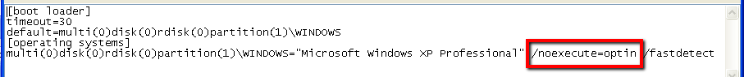
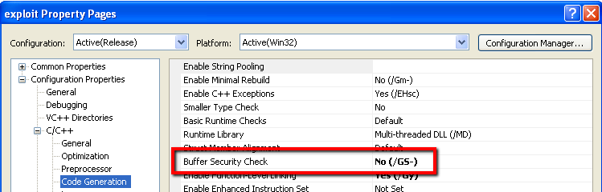
Protection
DEP
alwaysoff
GS – Visual C++ Compiler Flag
http://msdn.microsoft.com/en-us/library/Aa290051

Slide 29
Tools - Windows
Visual C++
Ida
Ollydbg
Additional Tools
Cygwin (arwin, nasm, objdump)
Faultmon
Perl (Strawberry)

Slide 30
Ida - Disassembling
Open the file
Pass through the options
Right click on the view and click Text View

Slide 31
OllyDbg - Debugging
Open the .exe or attach to the running process
Enter your data into the process
Check out the stack, esp, ebp, and eip registers at the time of the crash
If possible
Open the source file
Run until the buffer overflow should occur

Slide 32
Shellcoding
Find a solid assembly base (unless you want to write it all yourself…)
Find your system call memory addresses with arwin
Decide what you want to do
nasm into bytecode
Objdump to get the bytecode in text format
Determine big-endian or little-endian (this is where that matters)

Slide 33

General Overview Unix
Run the test program with lots of large sized input until it explodes
If it explodes, try running through GDB and see which information is being overwritten
Using that information and a combination of nasm and objdump create some malicious shell code
Enter the shellcode at different offsets until a shell appears
rm –rf /

Slide 34
Protection Linux
Turn off ASLR
sudo sh –c ‘echo 0 > /proc/sys/kernel/randomize_va_space’
Don’t randomize the address space in which programs execute
excecstack your binary
We couldn’t find a system-wide setting for turning off DEP on Linux
Workaround – execstack -s <my binary>
Formally tells the OS that you’re a terrible programmer and you don’t care if code you didn’t write executes on your behalf

Slide 35
Tools - Unix
GCC
GDB
Additional Tools
objdump
nasm
execstack

Slide 36
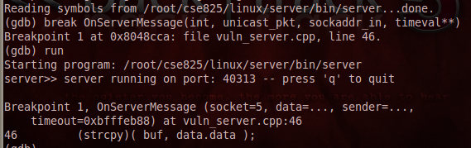
GCC & GDB
Making your program debuggable
gcc -g -o my_program my_program.c
Debugging for overflows
break <symbol>
Symbols include line number, function name, assembler label
Command also mapped to character ‘b’

Slide 37
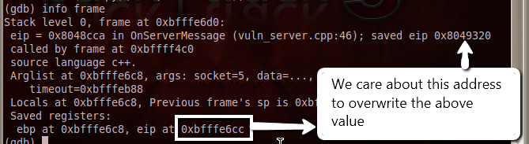
GCC & GDB
Making your program debuggable
gcc -g -o my_program my_program.c
Debugging for overflows
info frame
Prints everything the debugger knows about the current stack frame
Program needs to be executing

Slide 38
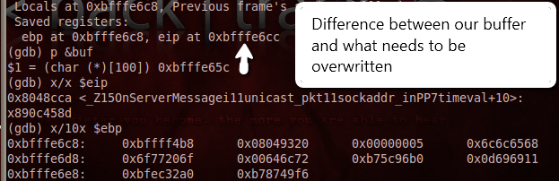
GCC & GDB
Making your program debuggable
gcc -g -o my_program my_program.c
Debugging for overflows
print, x/x
Print the value of any symbol
Incredibly powerful with options

Slide 39
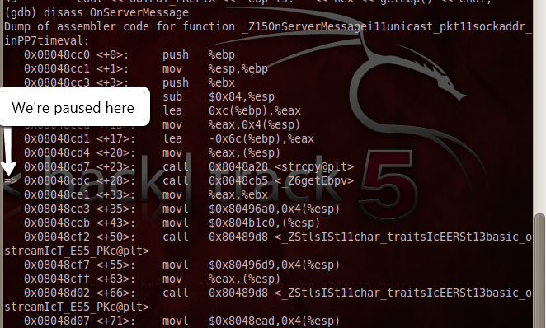
GCC & GDB
Debugging for overflows
disassemble <symbol>
Dumps the disassembly for a symbol

Slide 40
Assembly (Intel x86) Windows
jmp short GetCommand ;jump to the location of the command string
CommandReturn: ;Define a label to call so that string address is pushed onto stack
pop ebx ;ebx now points to the string
xor eax,eax ;empties out eax
mov [ebx + 7],al ;insert the NULL character
push eax ;push null onto stack as empty parameter value
push ebx ;push the command string onto the stack
mov ebx,0x7c86250d ;place address of WinExec into ebx
call ebx ;call WinExec(path,showcode)
xor eax,eax ;zero the register to clear WinExec return value (return values are often in eax)
push eax ;push null onto stack as empty parameter value
mov ebx,0x7c81cb12 ;place address of ExitProcess into ebx
call ebx ;call ExitProcess(0);
GetCommand: ;Define label for location of command string
call CommandReturn ;call the return label so the return address (location of string) is pushed onto stack
db "cmd.exeN" ;Write the raw bytes into the shellcode that represent our string.

Slide 41
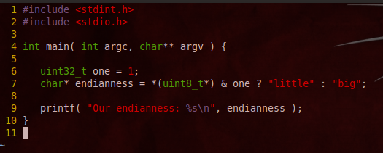
Determining Endianness
Why?
Need to know byte ordering for return address
For return address 0xbffff56c input “\x6c\xf5\xff\xbf”
How?

Slide 42
Day Two
Buffer Overflowin

Slide 43
Review of Homework

Slide 44
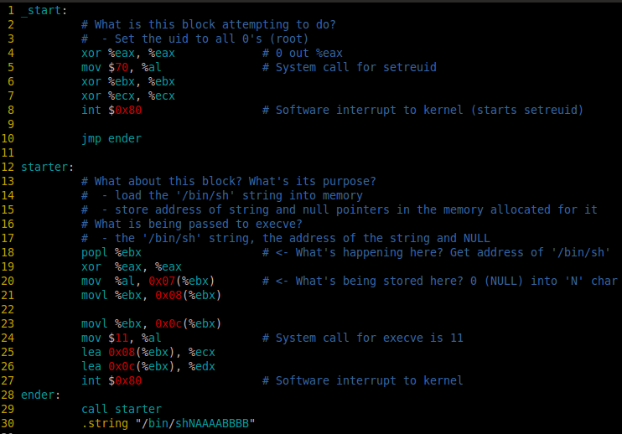

Slide 45
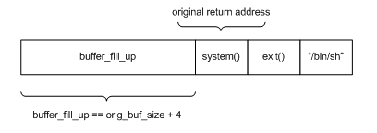
Return to LibC Attack
Perform buffer overflow using shellcode to obtain a new shell
Use LibC Functions
System()
Execve()/WinExec()
Call the desired function directly

Slide 46
Protection Against Buffer Overflows
Data Execution Prevention
Linux, Mac, Windows
Hardware Marks all locations in a process as non-executable unless the location explicitly contains executable code.
If an app tries to run this code, an error is thrown, calling process terminated
To Disable DEP –
Windows – recovery and startup sessions, edit the system startup, replace the line OptIn with always out (/noexecute=AlwaysOff)
Linux –
Echo 0 > /proc/sys/kernel/exec-shield
Echo 0 > /proc/sys/kernel/exec-shield-randomize
Notes:
Here are the different ways that systems protect against buffer overflows:
1- Data execution prevention (been around in Linux, Mac and windows since about 2004).
This prevents an application from executing code in a non-executable memory region.

Slide 47
Protection Continued
Address Space Layout Randomization
Randomly arranges the positions of key data areas
E.g. positions of library, heap, stack
If the location of lib.c changes everytime, then it will be hard to find the exact locations of different functions
Turn off ASLR
Linux – echo 0 > /proc/sys/kernel/randomize_va_space
Notes:
Is there ASLR in windows and if so how to turn it off?

Slide 48
Canaries
Known variables that are placed between a buffer and control data on the stack to monitor buffer overflows
If there is a buffer overflow, first to go will be the canary
Data then deemed corrupted
3 Types – Terminator, Random, Random XOR

Slide 49
Secure Bit
Hardware level flagging of mistrusted input
Bit flag indicates whether input is trusted or untrusted
If user input enters function pointer or return address section of memory, an exception is raised

Slide 50
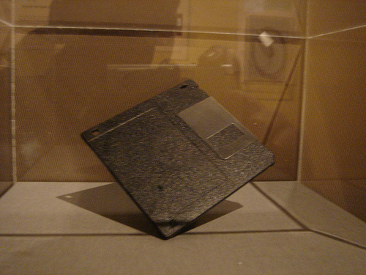
The Morris Worm
One of the first internet worms distributed via internet
November 2, 1988
Original Intent: Gauge the size of the internet
Self Replicating, Self Propagating
Buffer overflow in finger
Sentence
400 Hours of community service
$10,050 fine
3 years of Probation
Computer Science prof at MIT
$10-$100 Million in Damage
Notes:
The worm took advantage of a buffer overflow in the finger service, a service that dispenses information about the set of users logged into a UNIX-based computer system. Due to a coding error, it created new copies as
fast as it could and overloaded infected machines
When Morris realized what was happening, he contacted a friend at Harvard to discuss a solution. Eventually, they sent an anonymous message from Harvard over the network, instructing programmers how to kill the worm and prevent reinfection. However, because the network route was clogged, this message did not get through until it was too late. Computers were affected at many sites, including universities, military sites, and medical research facilities. The estimated cost of dealing with the worm at each installation ranged from $200 to more than $53,000.
Robert T. Morris was convicted of violating the computer Fraud and Abuse Act (Title 18), and sentenced to three years of probation, 400 hours of community service, a fine of $10,050, and the costs of his supervision. His appeal, filed in December, 1990, was rejected the following March.

Slide 51
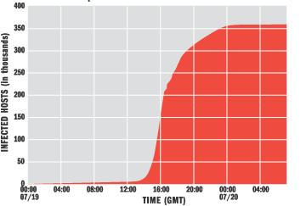
The Code Red Worm
July 13, 2001
Code Red: Drinking Code Red Mountain Dew
Defaced Websites
“Hacked by Chinese!”
Infected over 250,000 Machines
Scanned the internet
Found Vulnerable Machines
Installed Itself
Found Buffer Overflow Vulnerability in Microsoft’s IIS web server
Notes:
The worm scanned the internet, identified vulnerable systems and infected these
systems by installing itself. The rate of scanning grew rapidly because each newly
installed worm joined others already in existence. Not only did the worm result in
defaced web pages on the systems it infected, but its uncontrolled growth in scanning
resulted in a decrease of speed across the internet—a denial of service attack—and led
to widespread outages among all types of systems, not just the Microsoft Internet
Information Server (IIS) systems it infected directly.
This graph shows the rapid spread of the Code Red infestation. The worm was programmed to switch from an "infection phase" to an "attack phase" at midnight GMT on July 20. The abrupt leveling off of the infection appears to be due to this switch.

Slide 52
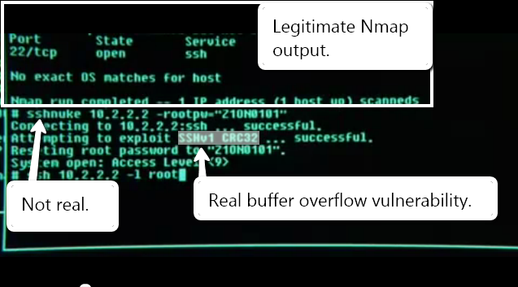
Still Relevant in 2199
http://www.youtube.com/watch?v=51lGCTgqE_w

